Slide 1
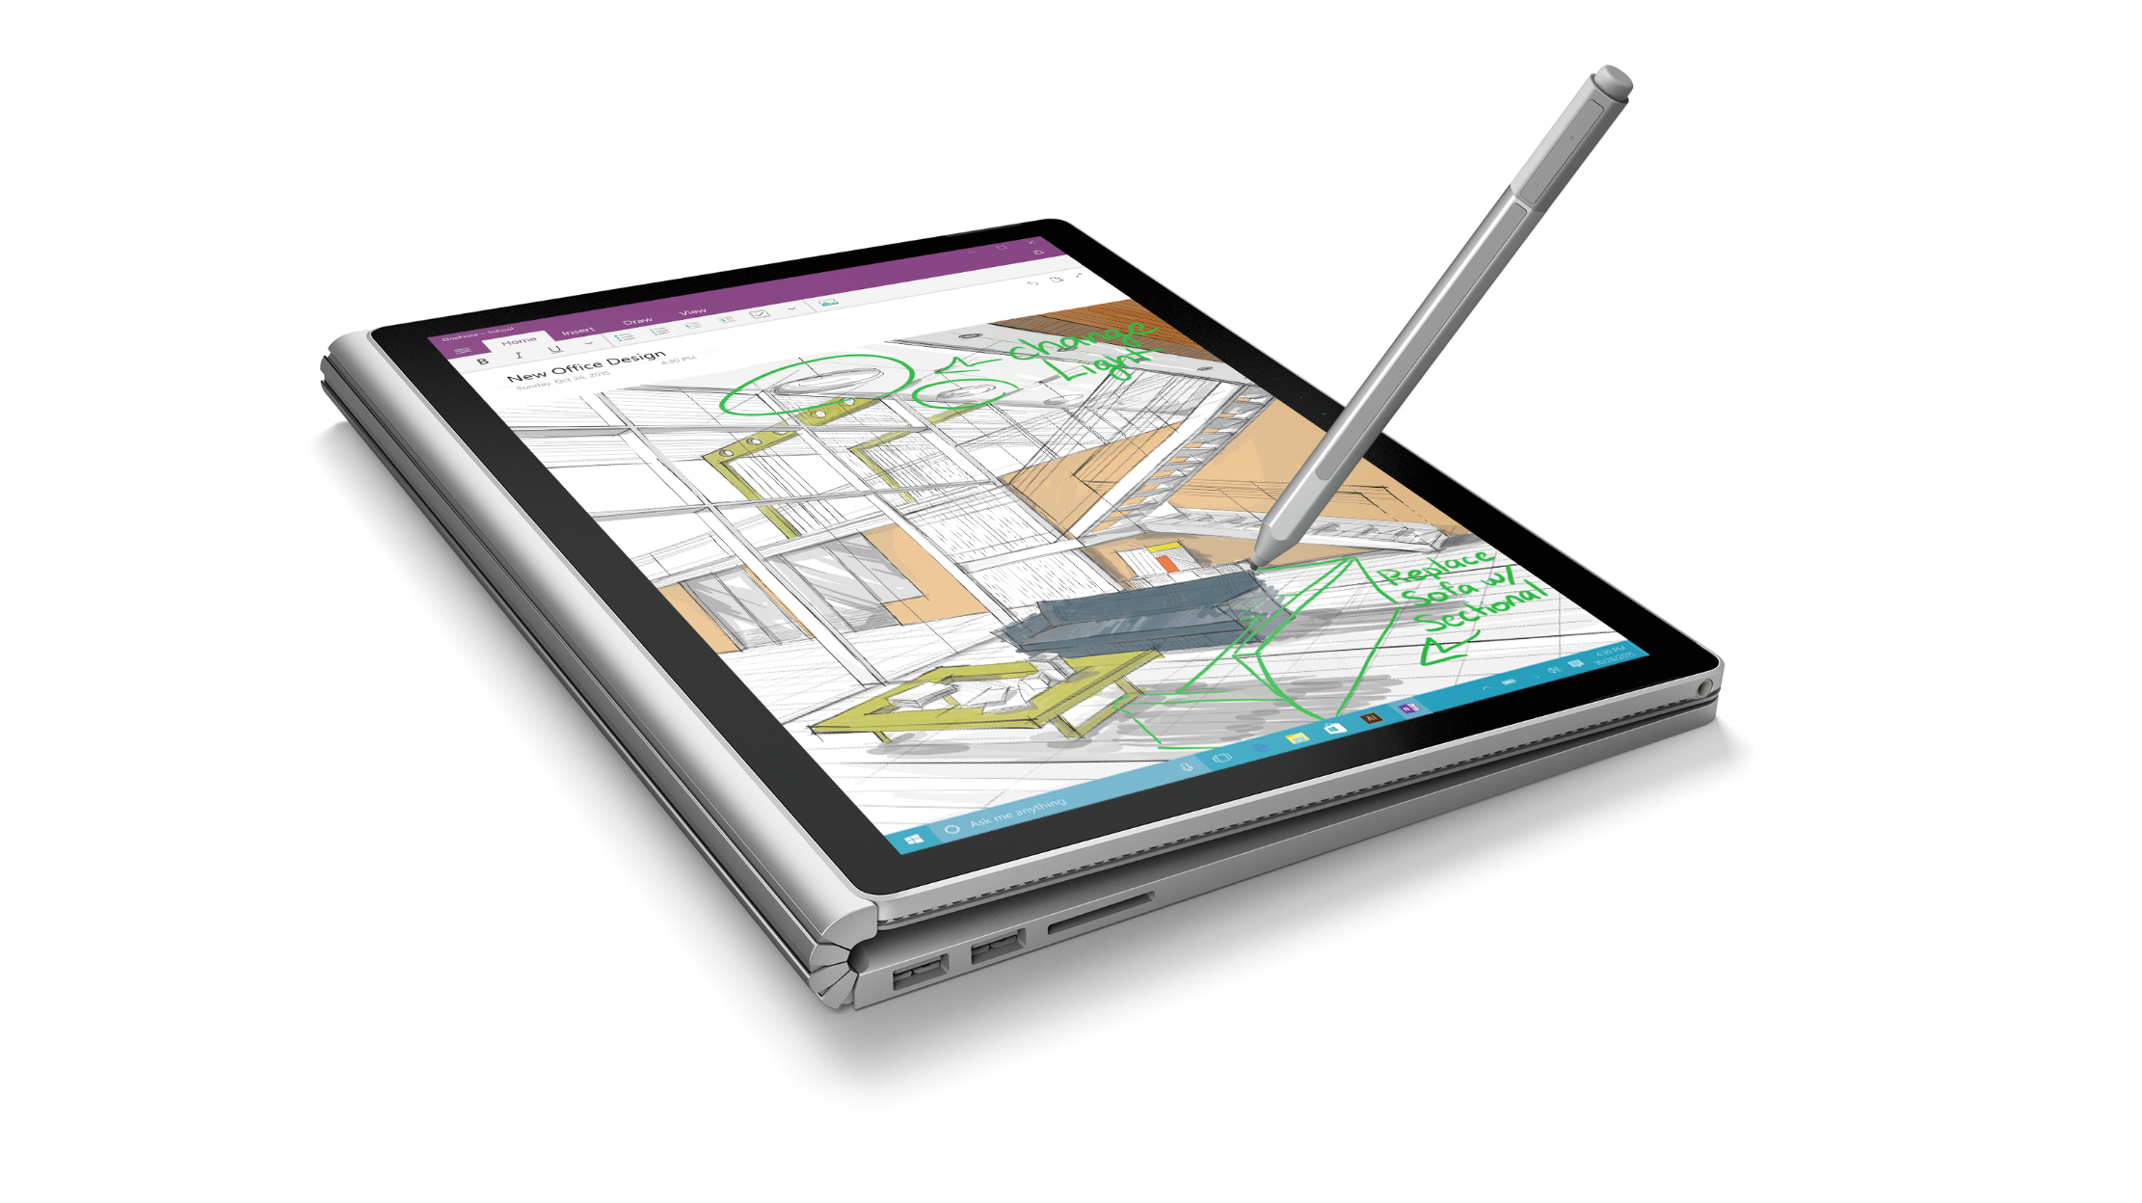
Welcome and Setup Windows 10 Developer Workshop

Slide 2
Welcome
This is a hands-on learning event
Not many slides! Lots of coding!
Instructor will lead you through the labs
Try to keep up
If you run into problems, raise your hand and one of our proctors will try to help
Your machine should be running:
Windows 10
Visual Studio 2015

Slide 3
WiFi
SSID: <tbc>
Password: <tbc>

Slide 4
Housekeeping

Slide 5
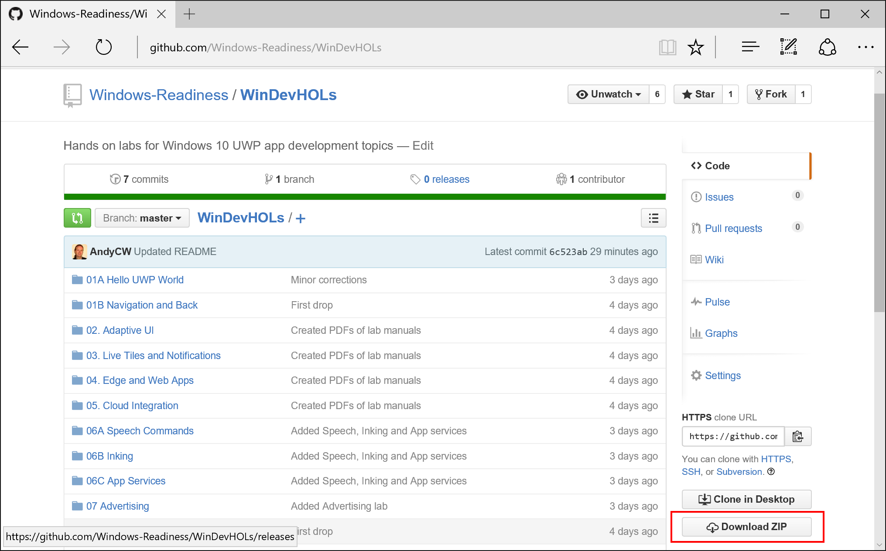
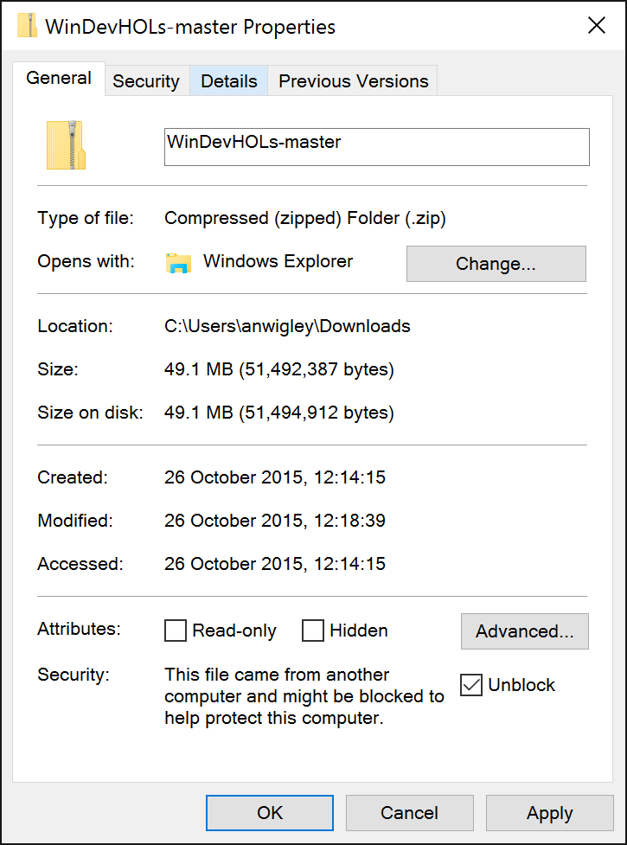
Install Lab Files
Copy zip from USB if available, or Download from:
https://github.com/Windows-Readiness/WinDevHOLs
Unzip to folder of your choice, e.g. C:\HOLs
If downloaded, remember to Unblock zip before unzipping

Slide 6
Agenda - morning
Time | Topic | Outline | Hands on Labs
9:00 -10:00 | Registration Welcome + Setup
10:00 -11:00 | Intro to Windows 10 UWP | One Windows, One Store, One SDK Device Families Adaptive UI to create great UI across all devices | A. Hello UWP World B. Page navigation and Back
11:00 – 12:00 | Building an adaptive UI | Design guidance Adaptive UI Relative panel Visual State Setters Adaptive Triggers | Building an adaptive UI
12:00 – 12:30 | Live Tiles and Notifications | Adaptive Template Interactive Toast | Live Tiles Basics Badge updates Tile Updates Interactive Toasts
12:30 – 13:30 | Lunch

Slide 7
Agenda - afternoon
Time | Topic | Outline | Hands on Labs
13:30 – 14:30 | Microsoft Edge and Hosted Web Apps | Edge WebView Hosted Web Apps | Hosted Web Apps Web apps calling UWP APIs
14:30 – 15:30 | Cloud Services | Connected Experiences Roaming Data OneDrive Azure App Services | Connecting your app to Azure App Service Mobile Apps
15:30 – 16:00 | Break
16:00 – 17:00 | More Personal Computing | Cortana/Speech Inking Windows Hello/Face Reco | A. Launching apps with voice commands B. Inking
17:00 – 17:30 | Store and Monetization | One Store App Submission Walk through In app purchase Advertising | Interstitial advertisements
17:30 | Close

Slide 8
Agenda - afternoon
Time | Topic | Outline | Hands on Labs
13:30 – 14:30 | Microsoft Edge and Hosted Web Apps | Edge WebView Hosted Web Apps | Hosted Web Apps Web apps calling UWP APIs
14:30 – 15:30 | Cloud Services | Connected Experiences Roaming Data OneDrive Azure App Services | Connecting your app to Azure App Service Mobile Apps
15:30 – 16:00 | Break
16:00 – 16:30 | More Personal Computing | Cortana/Speech Inking Windows Hello/Face Reco | Inking
16:30 – 17:00 | App Services | App Services | Building an App Service
17:00 – 17:30 | Store and Monetization | One Store App Submission Walk through In app purchase Advertising | Interstitial advertisements
17:30 | Close
Notes:
Regions *without* Cortana support

